Slide 1
Towards Context Aware Computations Offloading in 5G Anna Reale, Melinda Tóth, Zoltán Horváth ELTE, Eötvös Loránd University, Budapest, Hungary
Notes:
the mobile
nature of continuous interactive scenarios like real time speech
recognition or augmented reality, requires adaptive algorithms and
context aware architectures. In this paper we investigate both dynamic
and hybrid profiling, and adaptive partitioning, for a demanding
augmented reality use case, identifying a possible offloading
architecture.

Slide 2
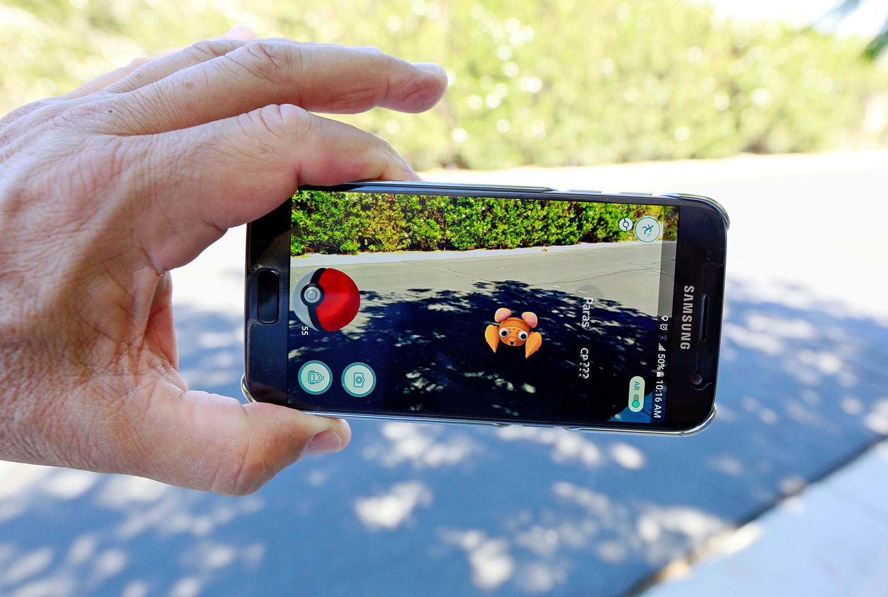
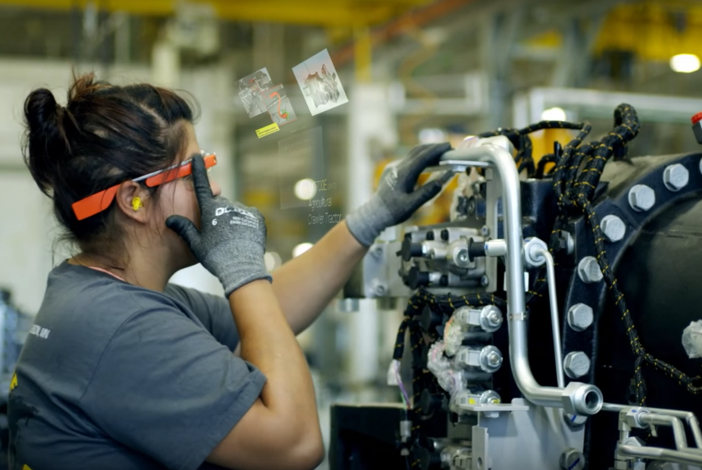
Continuous Interactive Applications
Interaction -> Responsivness
AR – MMORPGs…
= other resources used in a slide footer.
2 of 22
Notes:
Interaction characterised by
the interval of time to register and respond to a user event (responsiveness).
In Continuous Interactive Applications the interaction is real time and
almost constant, so this time must be as close as possible to zero.
Examples (AR) solutions or MMORPGs (Massive Multiplayer Online Role-Playing Games).

Slide 3
CIA requirements
Interact with each other in real time
Temporal and spatial consistency
Fairness
Fidelity
= other resources used in a slide footer.
3 of 22
Notes:
Main requirements: enable participants
(even if in different locations) to interact with each other in real
time.
share the same application state (temporal
and spatial consistency)
have the same chance of participation
regardless of network conditions (fairness).
the representation within a simulation should be as similar as
possible to the real-world (fidelity).
In these scenarios latency is a known major barrier.
network latency has a lower theoretical limit, it is possible to reduce latency and improving
CIAs by applying computation offloading and by reducing physical
distance between server and user, through 5G and edge computing.

Slide 4
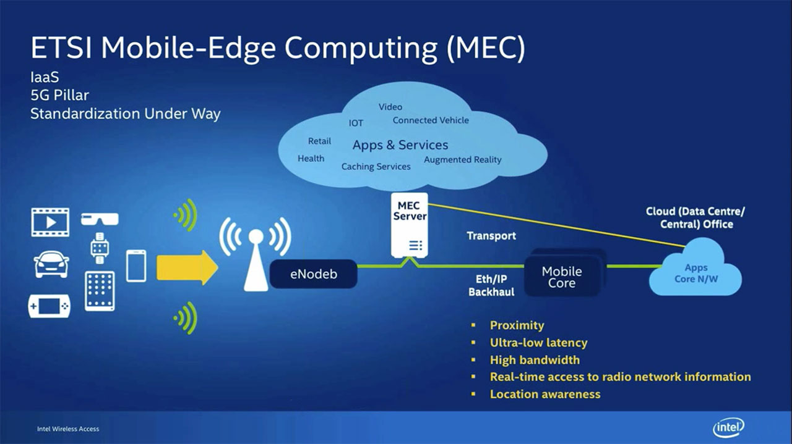
5G and MEC
4G adds 10ms+ latency to CIAs
= other resources used in a slide footer.
4 of 22
Notes:
Mobile Edge Computing (MEC) [13] is a network architecture
that suggests deploying cloud servers in each base station of the
mobile network.
State of the art 4G networks can add
from 10ms to more latency to CIAs, but the future 5G network
can be expected to be able to support real time and context aware
applications, being able to provide specific context information [19].

Slide 5
The Goal of Offloading Mapping application components between Device, edge and central Cloud
Application
CPU, Mem
fn
Data Char
Demanding application
fn
CPU, Mem
Data Char
Data Char
Data Char
Software Analysis
Data Char
fn
fn
fn
fn
fn
CPU, Mem,
Data Char
CPU, Mem
CPU, Mem
CPU, Mem
fn
fn
CPU, Mem
Mapping onto edge computing infrastructure
Device
Expose to 5G
Device
Edge Cloud
Central Cloud
BW, Delay
BW, Delay
CPU, Mem, Power
CPU, Mem, Power
CPU, Mem, Power
5 of 22

Slide 6
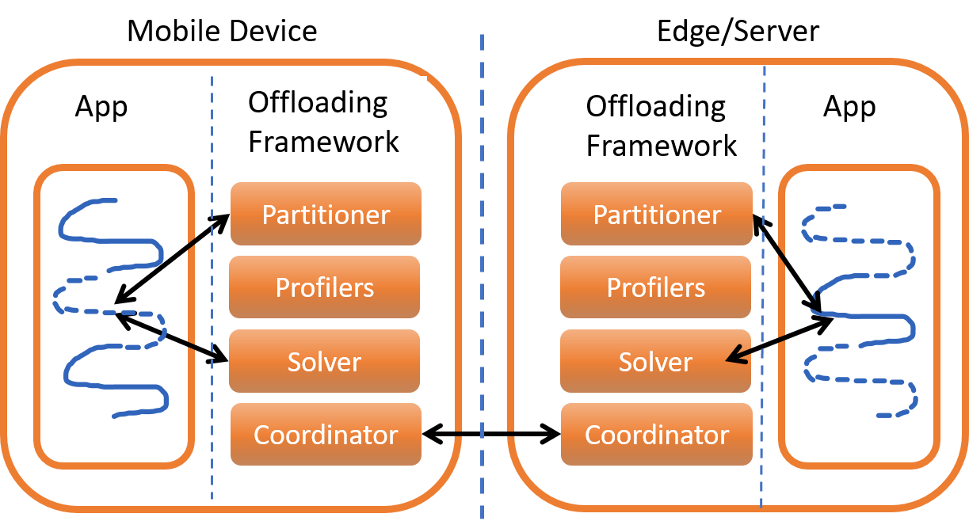
Basic Offloading Framework
6 of 22
Notes:
Based on these works, we can abstract a common architecture 2
consisting of the following components:
a partitioner decides which components are offloading
candidates. This decision is made based on static analysis of the
code.
The context monitor4: provides information about the context
of the migration: available edges, device battery status, network
connectivity, etc.
The solver: uses the data of the context monitor
and the partitioner candidates to
coordinator manages additional tasks that
hand over the computation, as in the case of verification and synchronisation.

Slide 7
Application partitioning
Granularity: Class, Component, Method, Module, Object, Thread…
Objective: Performance, Memory, NT overhead, Energy saving..
Partitioning Model: Graph, Linear, Hybrid
Profilers: HW, SW, NT
Partition Decision: Offline, Online, Hybrid
Analysis Technique: Dynamic or Static
Annotations: Manual or Automatic
= other resources used in a slide footer.
7 of 22
Notes:
The decision about whether to offload part of an application, depends
on a complex combination of factors: the size of the task, the
available resources, their distance, the actual latency, the cost of the
code, state and data migration itself in terms of energy consumption,
etc.
The decisions could be taken either online or offline. The difference
being in the higher computational overhead of online approaches.
An other dimension that could be considered is the type
of the gathered information used by the partitioning. It can be a
result of a static (based on the source code) or a dynamic (based
on runtime information) analysis. We propose a framework to use
both types of information.
Applications may be partitioned using automatic or manual
annotations.
The partitioning analysis can be performed using
a graph-based or a linear programming (LP) model. According
to [16] graph approaches perform better, consume less resources,
in comparison with LP.

Slide 8
Partitioning Frameworks
CloneCloud: miss optimal partitioning for different inputs.
Pedrosa et al.
Online profiling=> too much latency
Verbelen et al. : hybrid approach could be good for AR applications
= other resources used in a slide footer.
Notes:
Mmm maybe remove

Slide 9
Application partitioning
is challenging:
variation of resource requirements
heterogeneous devices.
An ideal solution should be context aware:
Choose granularity of partition
Adapt to NT changes
No interference with app behavior
= other resources used in a slide footer.
9 of 22
Notes:
. An ideal solution should consider which granularity
to choose for different mobiles and edges.
It should adapt to
changes in the network, without creating overhead and interfering
with the application behaviour.
Our solution aims to solve this as
well.

Slide 10
AR Requirements and Assumptions
A mobile device dedicated instance in the Edge
device users may lose connectivity
reconnect to the same or a different Edge
offloaded code and data should not be lost
= other resources used in a slide footer.
Notes:
3.1 AR Requirements
A mobile device user may offload code or data to a dedicated instance
in the Edge directly.
The mobile device communicates with
the instance using a cellular network via the Internet.
Because of
mobility, device users may lose connectivity to the edge, but might
later reconnect to the same or to a different one. I
n these cases, the
offloaded code and data should not be lost.
Mostly, the need for a latency lower than what the human eye
can perceive (25ms), pointed us toward a hybrid partitioning, using
a base pool of partitions created offline, and an algorithm for the online
selection based on the graph representation of the method level
Similar to [6]
The partitioning approach will imply running the application
on a small set of inputs to create a database of possible partitions
varying according to network and hardware resources availability.
Measuring through light profiling techniques will help reducing the
overhead.
When the setup threshold is passed, the new partitioning
will be deployed.
Logs that do not tamper with application can be
used to allow periodical offline analysis of the performance of the
partitioning. This way the database can be updated.
We decide to focus on a module level or a method level partitioning, and object
level partitioning was excluded because of the general dimensions
of OpenCV objects in the AR applications.

Slide 11
AR Requirements and Assumptions
hybrid partitioning
using a base pool of partitions
online selection based on the graph representation (method level)
= other resources used in a slide footer.
Notes:
3.1 AR Requirements
A mobile device user may offload code or data to a dedicated instance
in the Edge directly.
The mobile device communicates with
the instance using a cellular network via the Internet.
Because of
mobility, device users may lose connectivity to the edge, but might
later reconnect to the same or to a different one. I
n these cases, the
offloaded code and data should not be lost.
Mostly, the need for a latency lower than what the human eye
can perceive (25ms), pointed us toward a hybrid partitioning, using
a base pool of partitions created offline, and an algorithm for the online
selection based on the graph representation of the method level
Similar to [6]
The partitioning approach will imply running the application
on a small set of inputs to create a database of possible partitions
varying according to network and hardware resources availability.
Measuring through light profiling techniques will help reducing the
overhead.
When the setup threshold is passed, the new partitioning
will be deployed.
Logs that do not tamper with application can be
used to allow periodical offline analysis of the performance of the
partitioning. This way the database can be updated.
We decide to focus on a module level or a method level partitioning, and object
level partitioning was excluded because of the general dimensions
of OpenCV objects in the AR applications.

Slide 12
AR Requirements and Assumptions
Light online profiling techniques
threshold is passed, the new partitioning will be deployed
Logs periodical offline analysis of the performance of the partitioning
= other resources used in a slide footer.

Slide 13
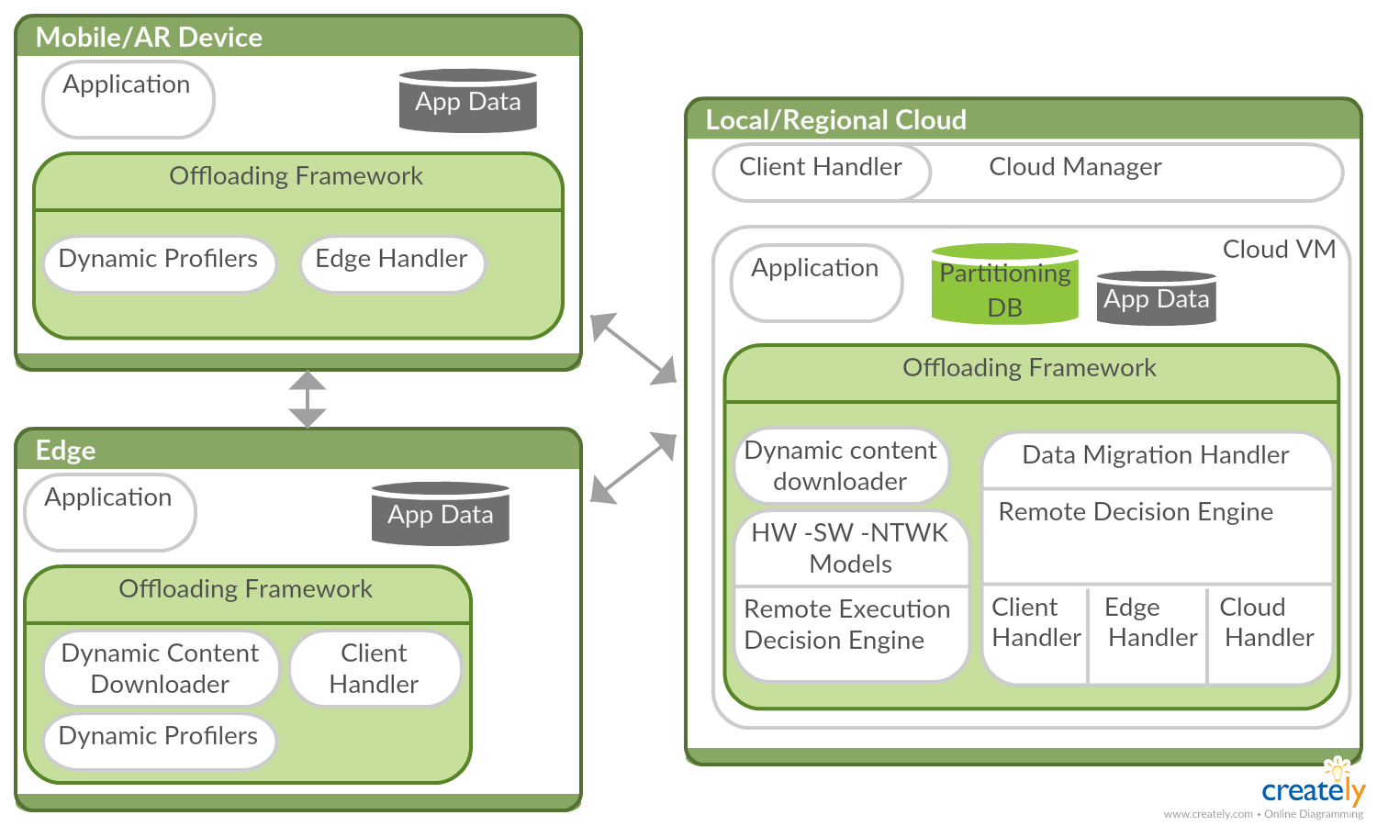
Offloading Framework
13 of 22
Notes:
It distinguish two supported types
of layers: the Edges and the Local clouds.
An Edge has virtual machine (VM) instances hosted by a public
cloud service near the mobile devices. Every application is assigned
to an instance for offloading and caching purposes. Instances can
communicate with each other and with the local cloud. A cloud is
a VM hosted by a resource-rich machine placed far enough from
the Edge.
.

Slide 14
Offloading Framework
14 of 22
Notes:
The Edge handler on the user device queries the nearest mobile
base station for the nearest Edge. If one is available for connection,
connects using a public IP address.
The App Data caches frequently offloaded codes with application
input data

Slide 15
Offloading Framework
15 of 22
Notes:
The Dynamic content downloader downloads input data for tasks
when a mobile device offloads computing tasks through the Internet,
so that the mobile device does not have to transmit input data with
the code, which saves energy.
As stated by Cuervo et al. [6] it does not make sense to complicate
Network measures: a simple TCP packet is enough to judge
latency. Main SW measures are the time spent for method and CPU
resources required. The main HW ones are available battery and
memory on device and on edge.

Slide 16
Offloading Framework
16 of 22
Notes:
The Cloud VM: the offloading framework in the cloud is placed
in a VM hosted by a virtualisation platform.
The Data migration handler manages data transmitted between a
mobile device and its instance on the Edge.
When the mobile device connects to the next nearest Edge, the handler of the new Edge connects to the
handler of the previous cloud to retrieve the code/data.
If the old Edge does not receive any requests for user data after a short time
period, it transfers the data back to the cloud to prevent data loss.
The Remote decision engine decides on whether to migrate unfinished
jobs with their data to the Edge or not.
The Remote execution decision engine is the decision making
component of the offloading framework. Whether and where to
offload data it is based on the selected partitioning and optimisation
algorithm. This engines takes the measurements provided by
the profilers as inputs. At execution time active profiles will be
monitoring: network bandwidth, user device energy and resources,
Cloud and Edge resources.
The Partition DB leads us to a hybrid solution. A set of preferable
partitions based on thresholds of the profiled metrics can be stored
in the DB. Every time the profilers register significant changes, the
best fitting partition will be implemented on a new instance, and
there will be an handover between the two.

Slide 17
Preliminary Results
Static Analysis tool
Profiler tools
Objective:
Graph representation with cost estimates
of a symple AR application
= other resources used in a slide footer.

Slide 18
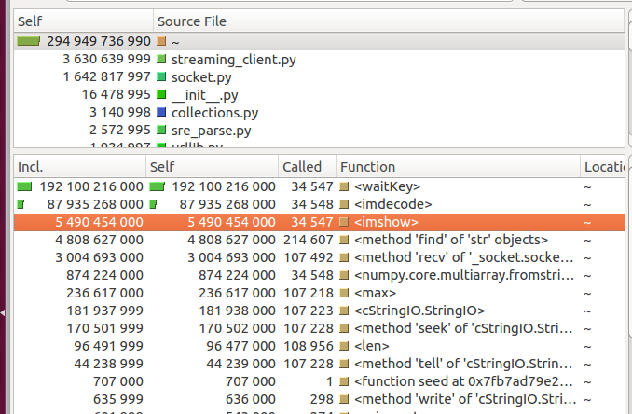
Tools
Callgrind
Oprofile
CProfile
Tool | Functions | CPU Clock | CPU Time | Call Graph | Modules | Map by Source
Oprofile | Y | Y | N | Y | Y | N
CProfile | Y | N | Y | Partially | N | Y
= other resources used in a slide footer.
Notes:
We created a simple AR application based on OpenCV, a face
recognition [11]. It recognise all the faces appearing on a video
stream and brackets them in real time. The augmented video stream
was rendered on a raspberry pi, representing our augmented reality
device. Our simplified distributed 5G network consisted of two
laptops simulating the Edge and the Cloud, connected via Ethernet
cable to a raspberry pi.
The application was divided into four different modules,
The Video Decoder receives a .jpg image from the streaming and
decodes into an array readable by OpenCV.
The Face recognition server receives a .jpg image from the streaming and does the full
processing: decodes it into an array readable by OpenCV, performs
the face pattern matching, draws a square around it, encodes back
to jpg, and sends the image to stream.
The Video Encoder converts an array of an OpenCV readable image into jpg.
Finally, the Face Recognition from encoded Image receives a decoded image, performs
a pattern match, draws a square around these and sends the still
decoded image for streaming.

Slide 19
Simple AR application
OpenCV
Face Recognition
= other resources used in a slide footer.
Notes:
We created a simple AR application based on OpenCV, a face
recognition [11]. It recognise all the faces appearing on a video
stream and brackets them in real time. The augmented video stream
was rendered on a raspberry pi, representing our augmented reality
device. Our simplified distributed 5G network consisted of two
laptops simulating the Edge and the Cloud, connected via Ethernet
cable to a raspberry pi.
The application was divided into four different modules,
The Video Decoder receives a .jpg image from the streaming and
decodes into an array readable by OpenCV.
The Face recognition server receives a .jpg image from the streaming and does the full
processing: decodes it into an array readable by OpenCV, performs
the face pattern matching, draws a square around it, encodes back
to jpg, and sends the image to stream.
The Video Encoder converts an array of an OpenCV readable image into jpg.
Finally, the Face Recognition from encoded Image receives a decoded image, performs
a pattern match, draws a square around these and sends the still
decoded image for streaming.

Slide 20
Simple AR application
Experiment | RPI | EDGE | CLI
S1 | Stream | Decode Detect Encode | Show
S2 | Stream Decode | Detect | Encode Show
S3 | Stream | Decode Detect | Encode Show
S3
S2
S1
Time spent
performing
detection
Notes:
Based on the static analysis tool and adding an average offloading
time (the communication cost between devices) we selected the
first partition to be the most efficient.
Running the application and profiling it with the profilers presented in Section 3.3 verified our
hypothesis.
Performance key parameter was the number of calls
and processing time in the face recognition activity, which is the
same in all cases. When compared S3 with S2, it processes a similar
amount of frames with a significant better usage of the computing
resources of the Edge. On the other hand, S1 performed in average
three times more frames. In fact, on a 5 minutes streaming, for
the same amount of total processor clocks, the number spent on
performing detection is 85.7% against the 26% of S2 and 19.6% of S3.
This was due to the fact that offloading time cost was greater: in case
of such a small application the partitioning only adds overheads to
the application performance.

Slide 21
Future Works
Real computational intensive AR app
Multiple devices and streams
Automatise partitioning tool chain
Selecting models for new UC
Adapth partitioning algorithm to multiple costs
= other resources used in a slide footer.

Slide 22
Contributions
Identify req for AR app on 5G
Select and test tool chain
Adaptable partitioning scheme
Define offloading framework for AR
…. Thank you!
= other resources used in a slide footer.

Slide 23
Some Reference
Byung-Gon Chun, Sunghwan Ihm, Petros Maniatis, Mayur Naik, and AshwinPatti. 2011. Clonecloud: elastic execution between mobile device and cloud. In Proceedings of the sixth conference on Computer systems. ACM, 301–314.
Luis D Pedrosa, Nupur Kothari, Ramesh Govindan, Jeff Vaughan, and Todd Millstein. 2012. The case for complexity prediction in automatic partitioning of cloud-enabled mobile applications. Small 20 (2012), 25.
Tim Verbelen, Tim Stevens, Filip De Turck, and Bart Dhoedt. 2013. Graph partitioning algorithms for optimizing software deployment in mobile cloud computing. Future Generation Computer Systems 29, 2 (2013), 451–459.
Eduardo Cuervo, Aruna Balasubramanian, Dae-ki Cho, Alec Wolman, Stefan Saroiu, Ranveer Chandra, and Paramvir Bahl. 2010. MAUI: making smartphones last longer with code offload. In Proceedings of the 8th international conference on Mobile systems, applications, and services. ACM, 49–62.
Charles Jose Ferrari. 2017. 5G Edge Computing Proof of Concept and Use Case Exploring. Master’s thesis. Eötvös Loránd University, Hungary,Budapest.
= other resources used in a slide footer.

